Slide 1
Compiler for Embedded System
Presented By: Shankar Khatri

Slide 2
Contents
Introduction
Role of Compiler in Embedded System Design
Compiler Optimization Techniques for ES

Slide 3
What is a compiler?
A program that reads a program written in one language and translates it into another language.
Source language Target language
Traditionally, compilers go from high-level languages to low-level languages.

Slide 4
Compiler Introduction (contd..)
Compilers help programmers use high level constructs without performance loss.
Compilers also help applications fully utilize architectural features.
Architectural features like parallel processing, pipelining, superscalar architecture like VLIW etc.
A goal of compiler and processor designers is to identify and take advantage of as much ILP as possible

Slide 5
Compiler Architecture
Intermediate
Language
Intermediate
Language
Source
language
Scanner
(lexical
analysis)
Parser
(syntax
analysis)
Semantic
Analysis
(IC generator)
Code
Optimizer
Code
Generator
Target
language
tokens
Syntactic
structure
Symbol
Table

Slide 6
Role of Compiler in Embedded System Design
Good Software Design
Good Hardware Design
System Integration – Compiler Bottleneck

Slide 7
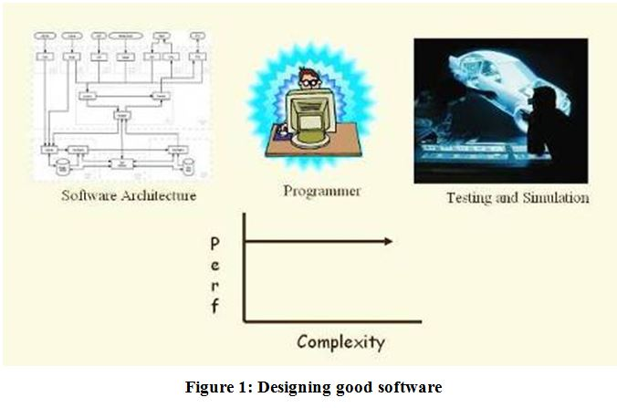
Good Software Design

Slide 8
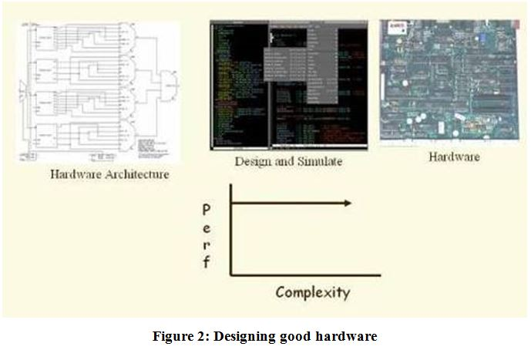
Good Hardware Design

Slide 9
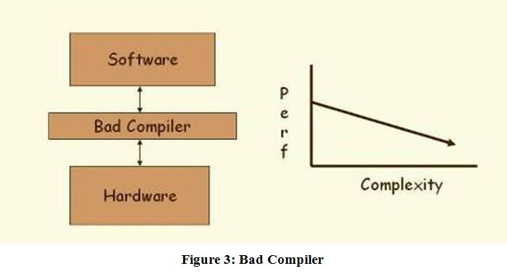
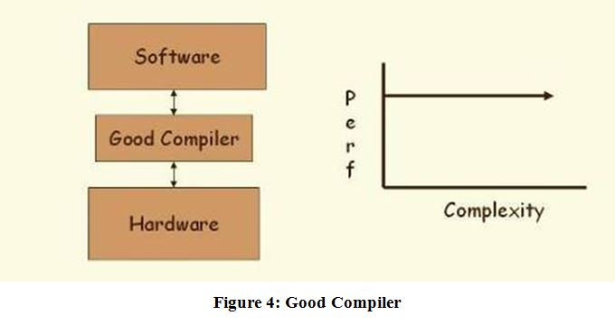
System Integration – Compiler Bottleneck

Slide 10
Compiler Optimization Techniques for Embedded Systems
Source Level Optimization
- loop transformations
- code rewriting technique for data reuse
- code size minimization technique
- dynamic memory allocation
- function inlining

Slide 11
Thank You

